Slide 1


CHIRURGIA PLASTICA, OBESITA’ E INFEZIONI DI FERITA
Dr.ssa Carlotta scarpa md phd
Clinic of Plastic Surgery and
Residency Program
in Plastic Reconstructive and Aesthetic Surgery
Chief Prof. Franco Bassetto
email: franco.bassetto@unipd.it
PADOVA, ITALY

Slide 2
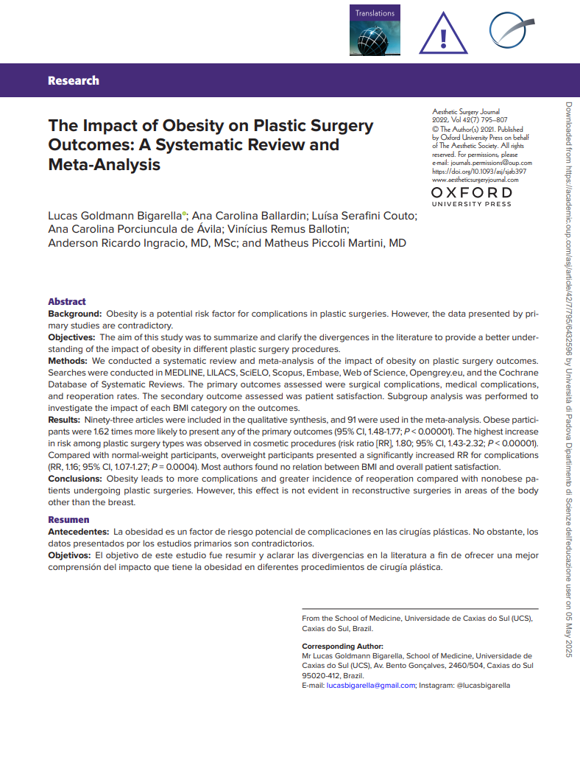
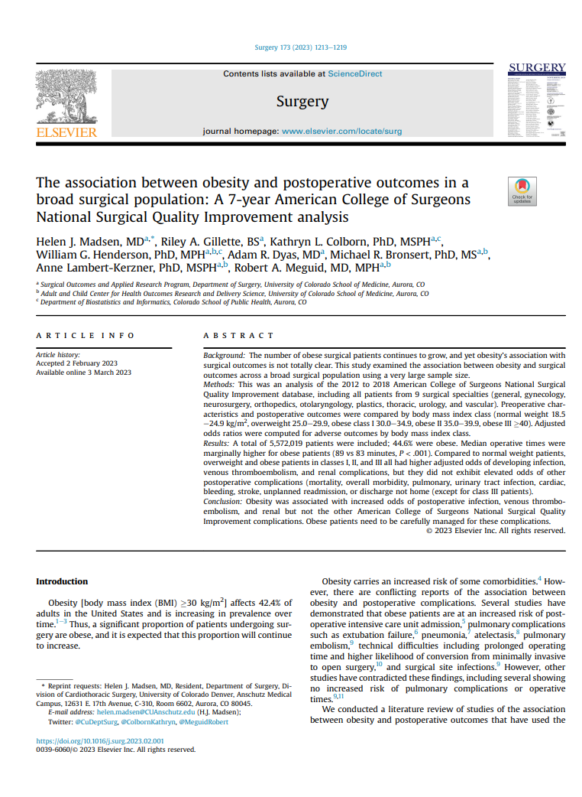

Slide 3
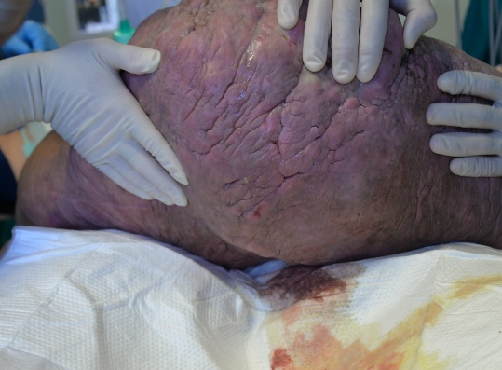
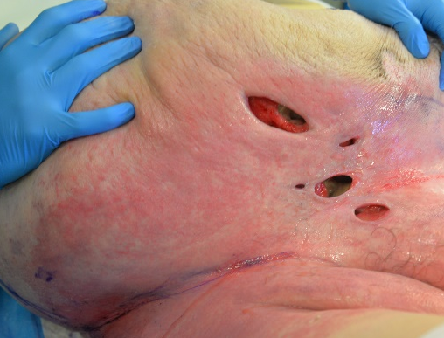
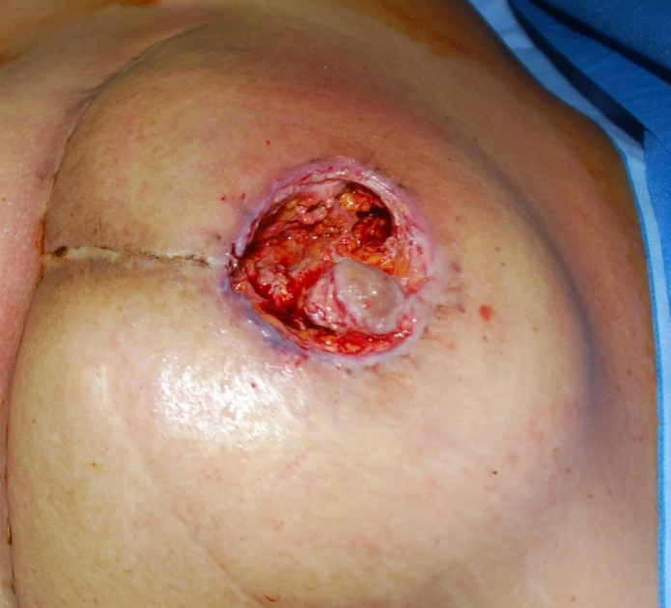
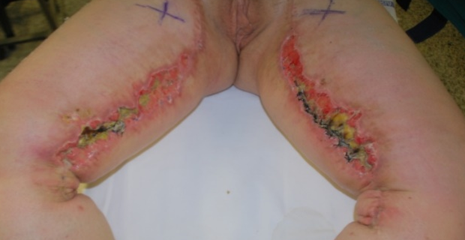

Slide 4


Slide 5
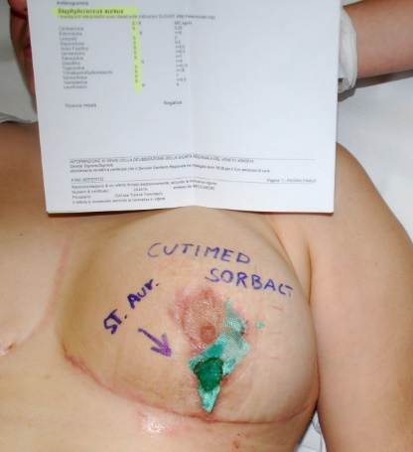
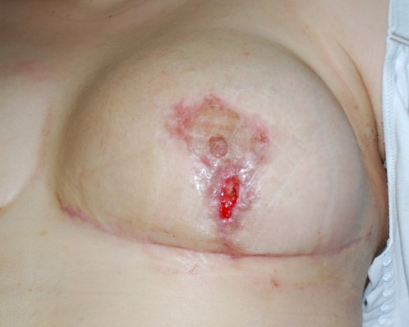
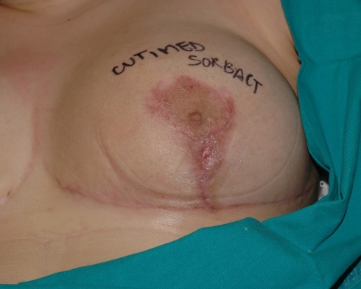
ADVANCED DRESSING? YES…but.
DACC TECHNOLOGY: HYDROPHOBIC DRESSING
I application
Fup 2 days
Fup 14 days

Slide 6
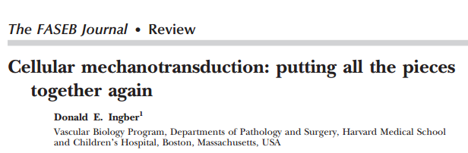
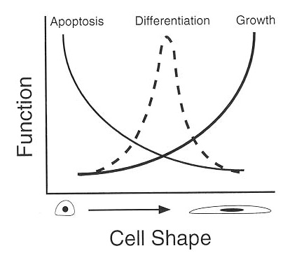
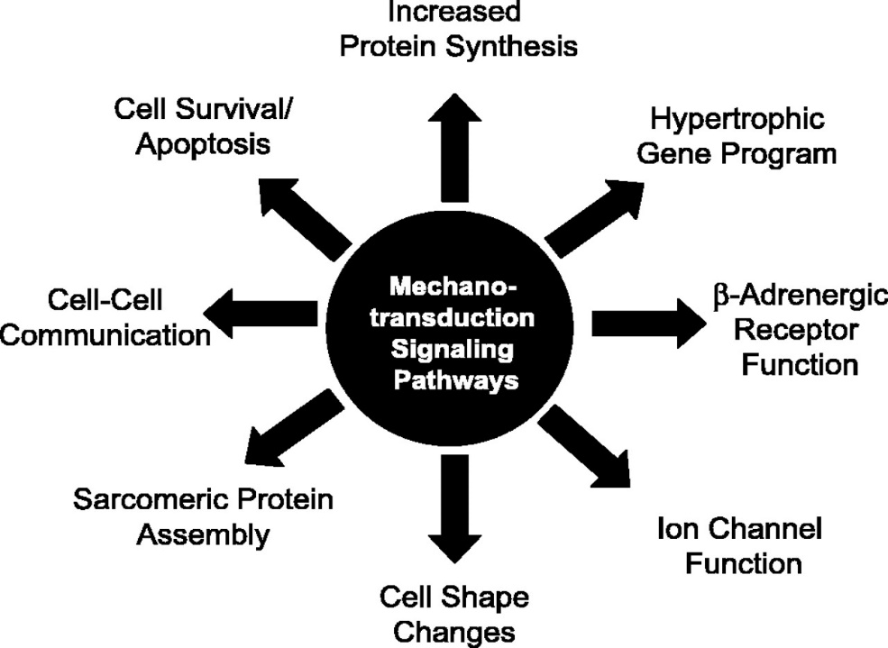
NEGATIVE PRESSURE WOUND THERAPY
Mechanical forces and Mechanobiology
Donald Ingber,FASEB 13 Sup S5 1999

Slide 7
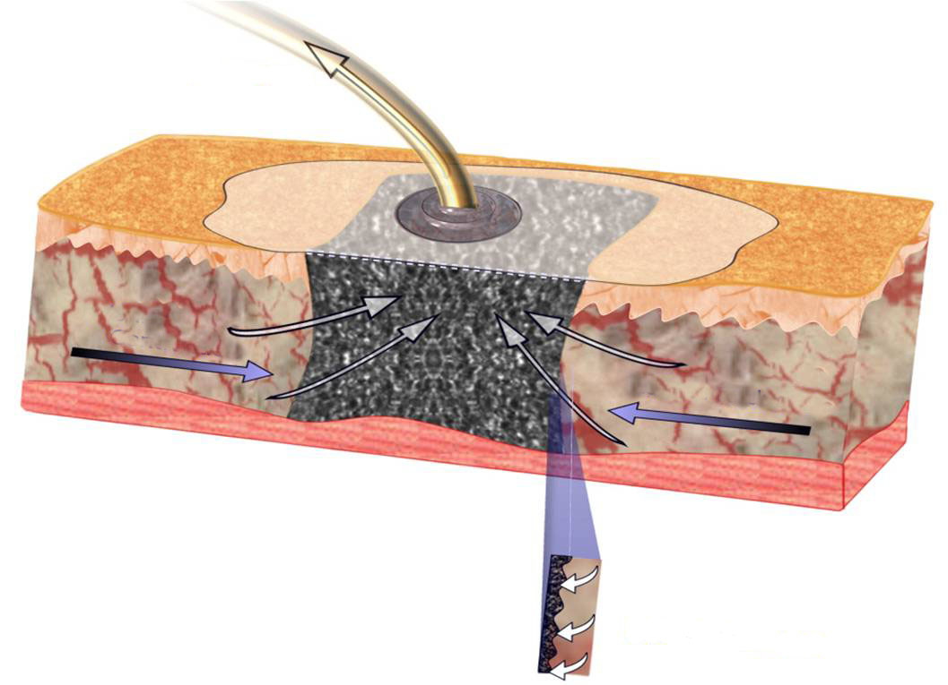




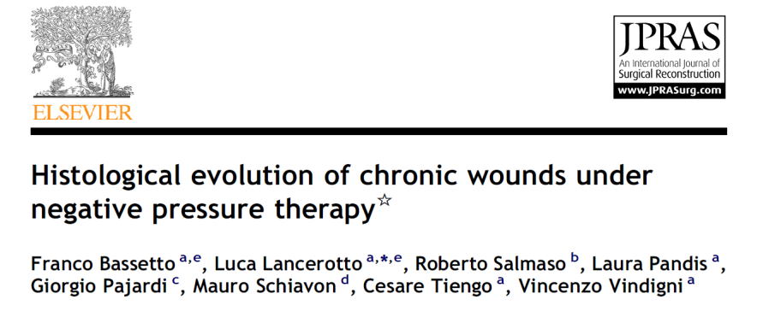
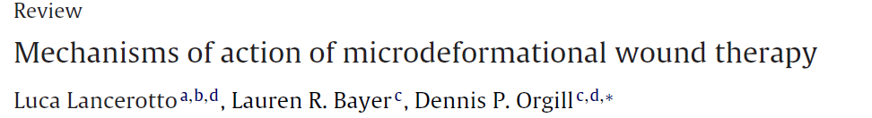
NEGATIVE PRESSURE THERAPY
CONTRACTION OF THE MARGINS
MICROENVIROMENT STABILIZATION
  Removal of flogistic mediators
  (↓ Matrix Metallo-proteinases
  ↑ Mitogen-Activated Kinases );
  Reduction of bacteria load
EDEMA REDUCTION
  Reduction of exudate and interstitial fluis
  Reduction of hydrostatic and osmotic pressure
  Stimulation of capillary blood flow
MICROMECHANICAL STIMULATION
  Proliferation and cellular migration
  Angiogenesis, perfusion, tissutal oxigenation
  Rehepitelization

Slide 8
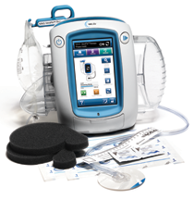
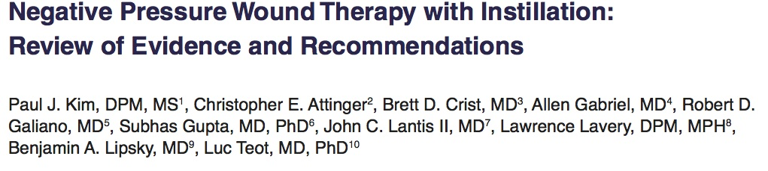
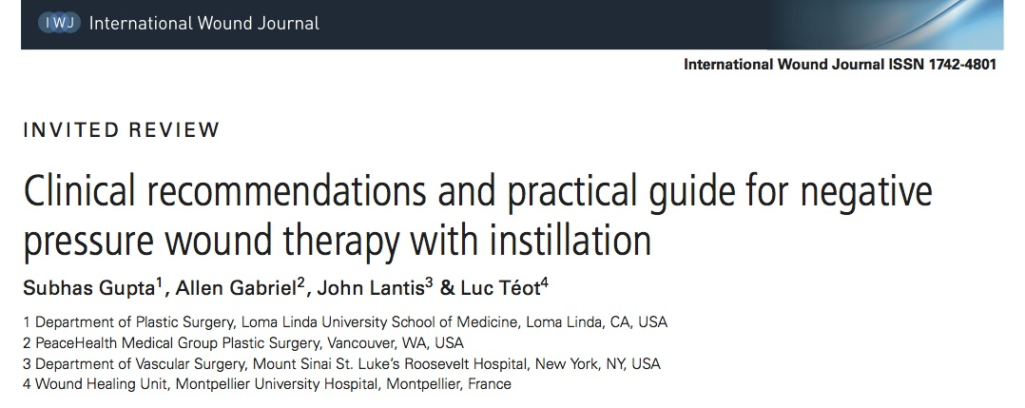
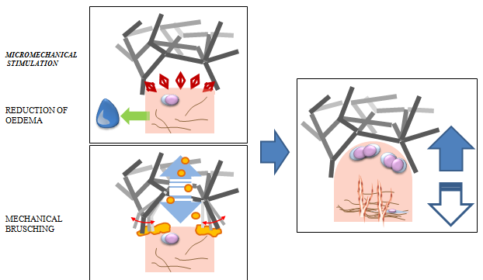
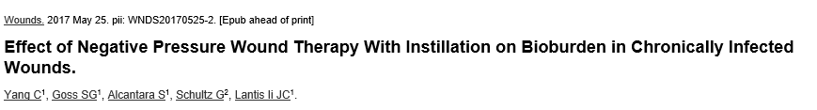
NEGATIVE PRESSURE THERAPY
WITH INSTILLATION
2015
2011
2016

Slide 9
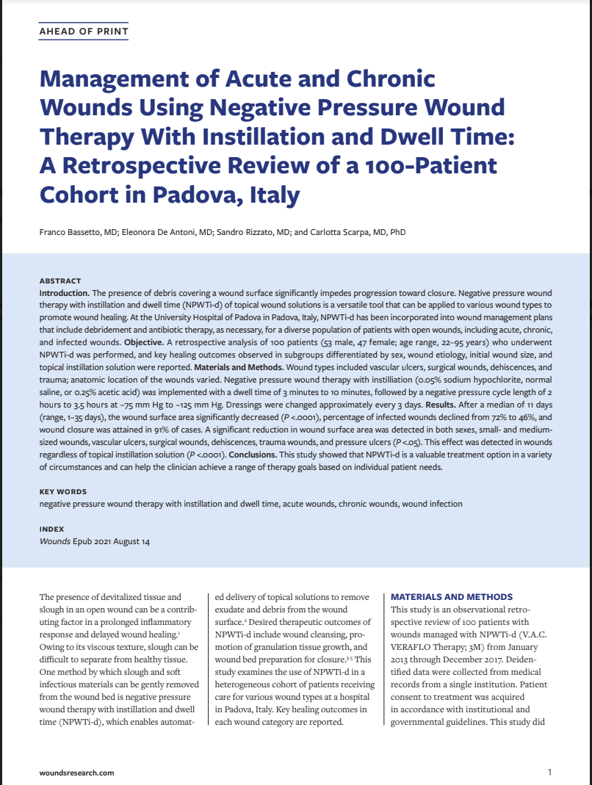
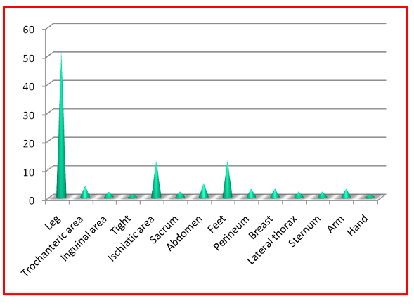
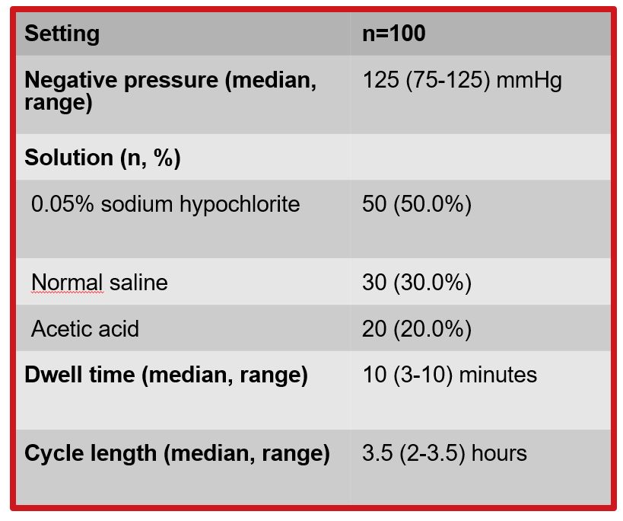
THE AREAS
NPWTI
FEATURES
Notes:
9
9

Slide 10
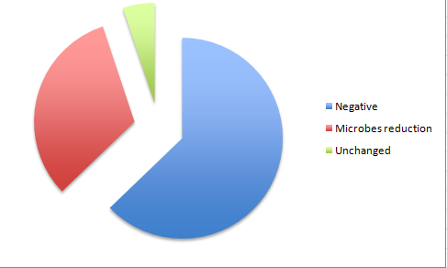
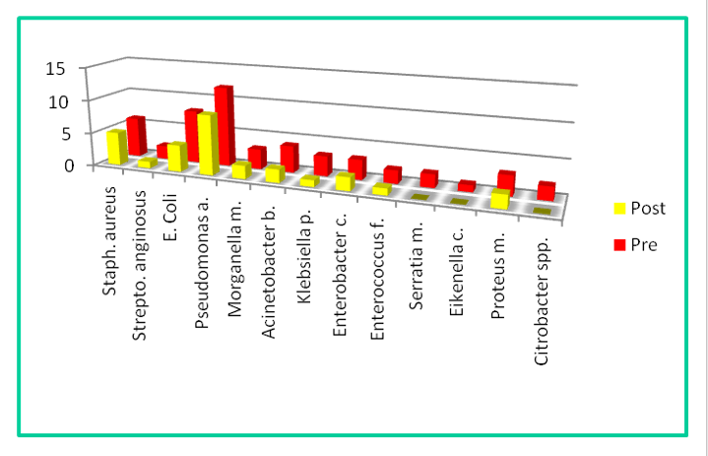
Management of Acute and Chronic Wounds Using Negative Pressure Wound Therapy With Instillation: A Retrospective Review of a 100-Patient Cohort in Padua, Italy
F. Bassetto, E. De Antoni, S. Rizzato, C. Scarpa
Wounds. 2021 Aug 14. doi: 10.25270/wnds/081421.01.
EFFICACY ON SWABS
Notes:
10
10

Slide 11

SOME CLINICAL CASES

Slide 12
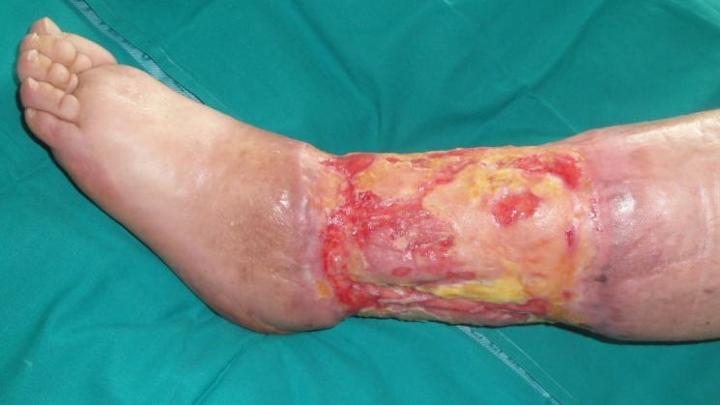
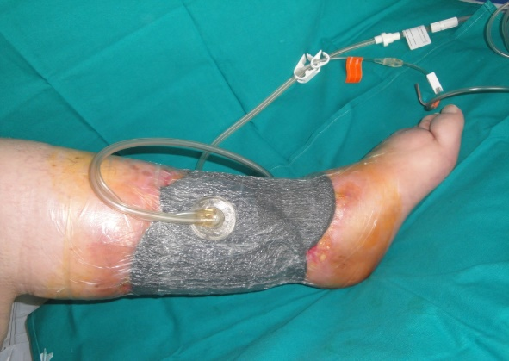
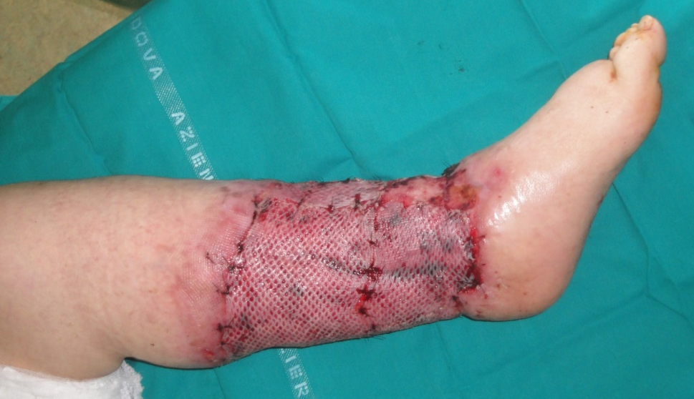
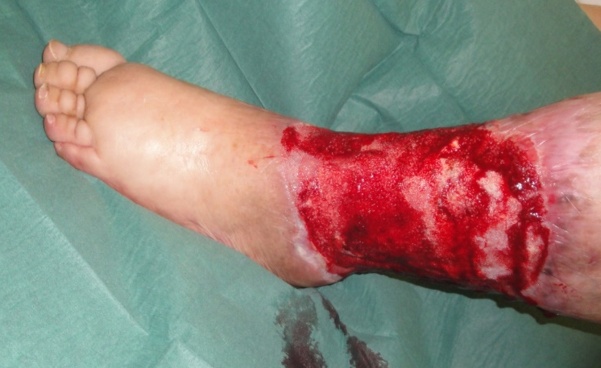
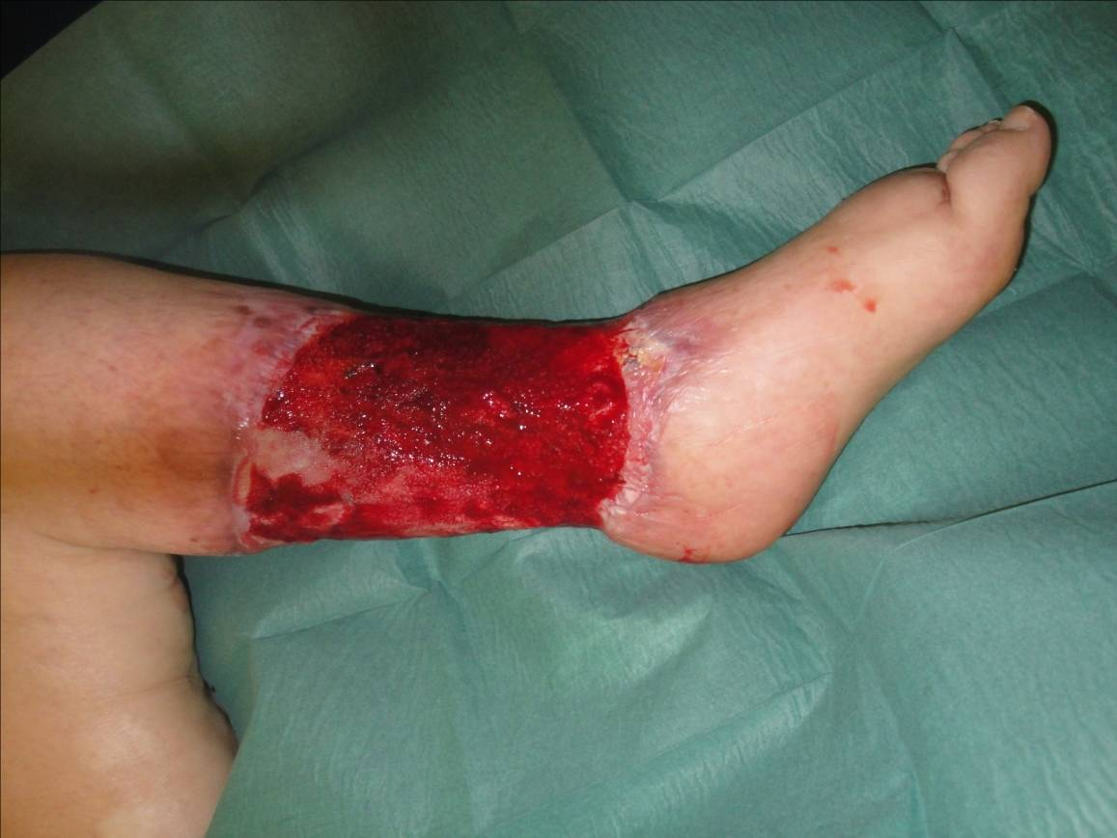
NEGATIVE PRESSURE THERAPY WITH INSTILLATION IN
CHRONIC WOUNDS IN OBESE PATIENT

Slide 13
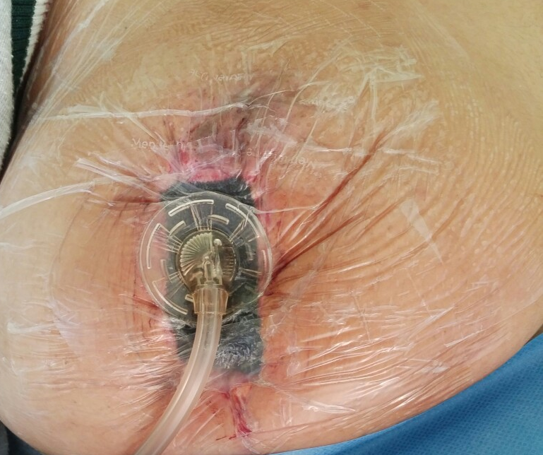
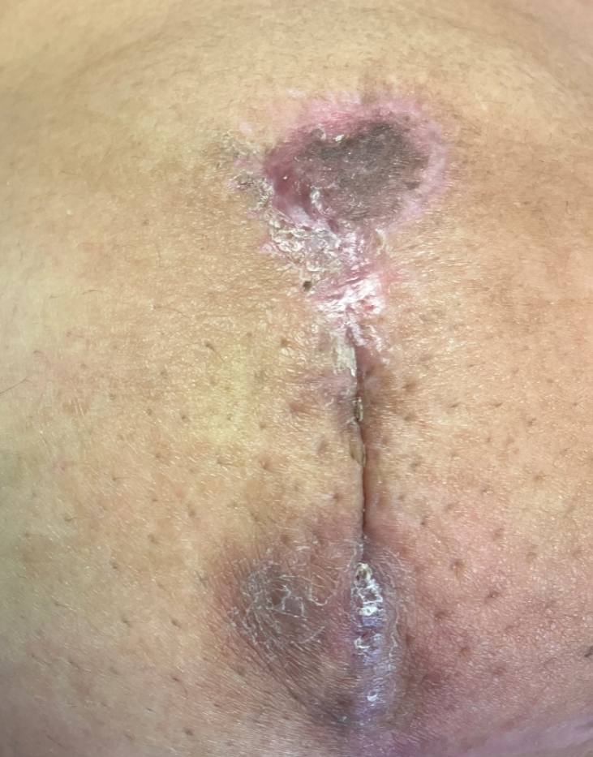
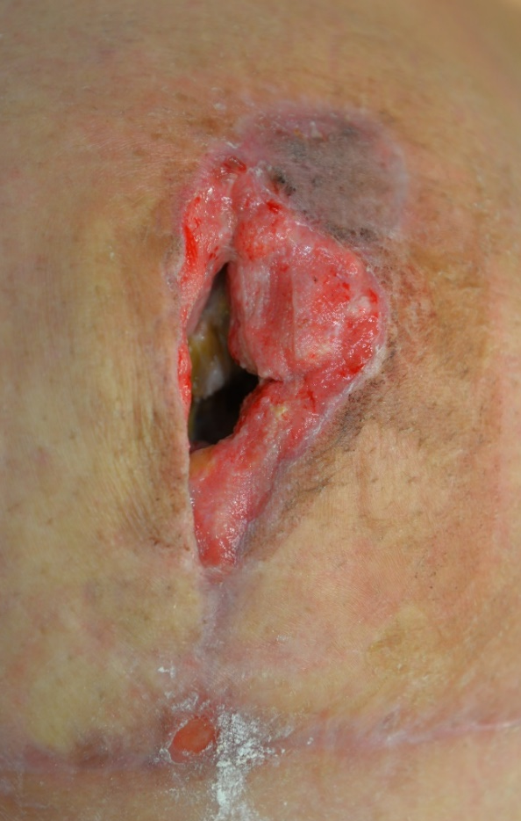
POST BREAST REDUCTION
NPWTi with saline for Staphylococcu aureus
Preop
(after 7 days NPWTi)
Postop
(after 3 months)

Slide 14
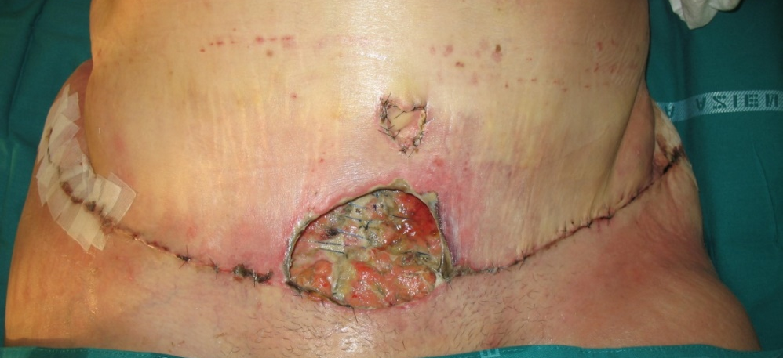
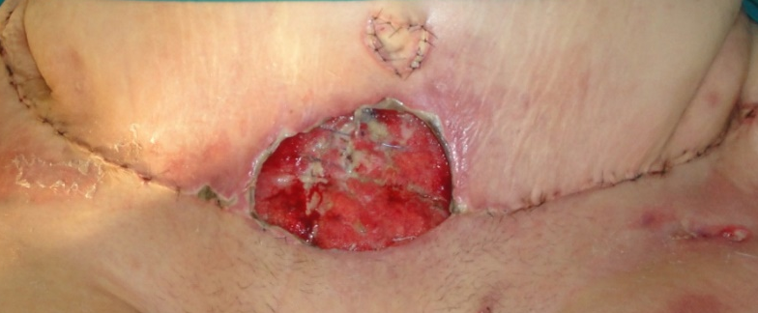
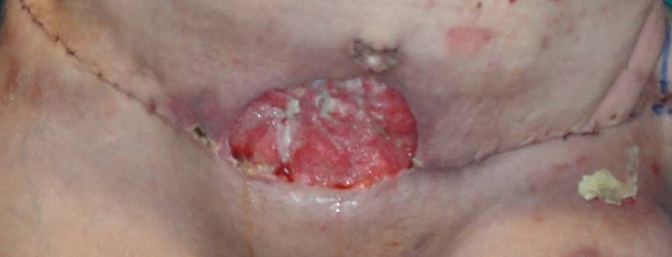
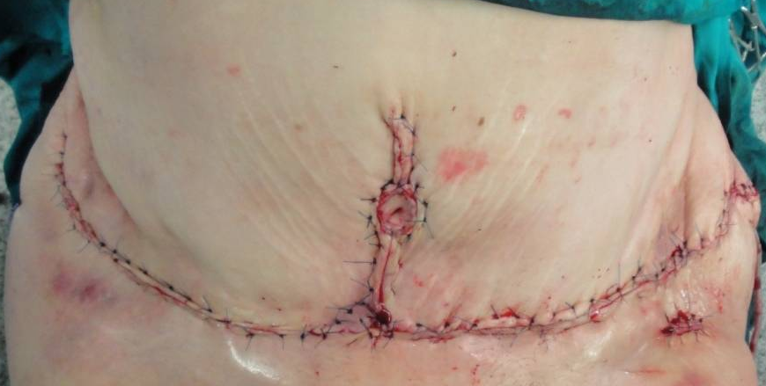
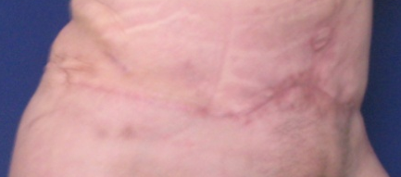
Post surgical Abdominal Infection after Abdominoplasty
NPWTi for Serratia Marescens
day 5
day 11
Scarpa C, Bassetto F, Vindigni V Management of Severe Wound Infections After Body Contouring Procedures in Post-Bariatric Patients With Negative-Pressure Wound Therapy With Instillation Plast Reconstr Surg. 2022 Apr 1;149(4):839e-841e

Slide 15
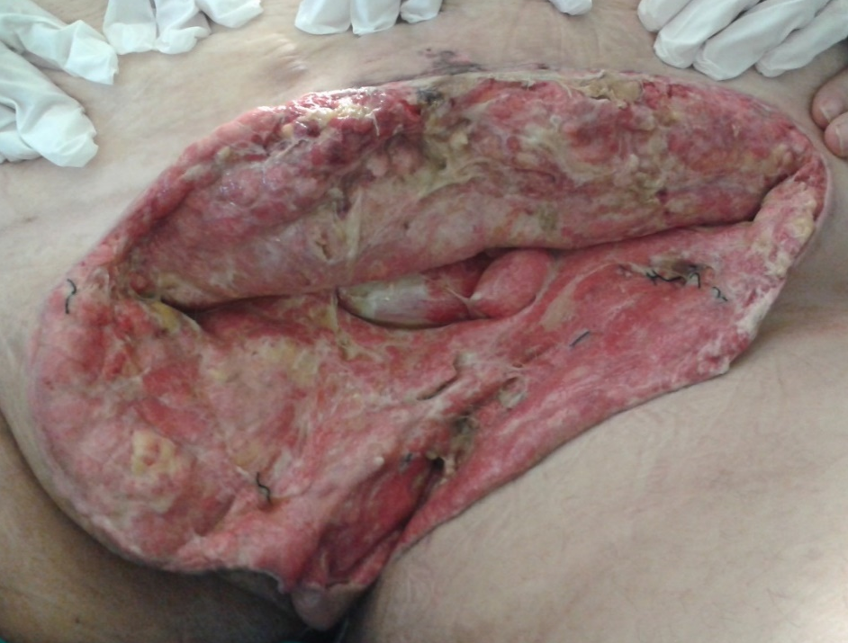
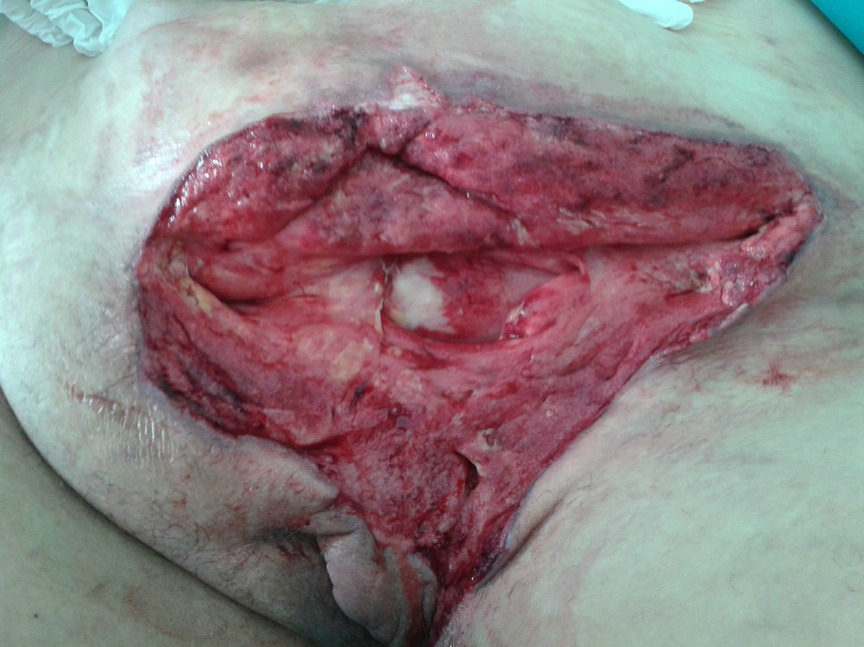
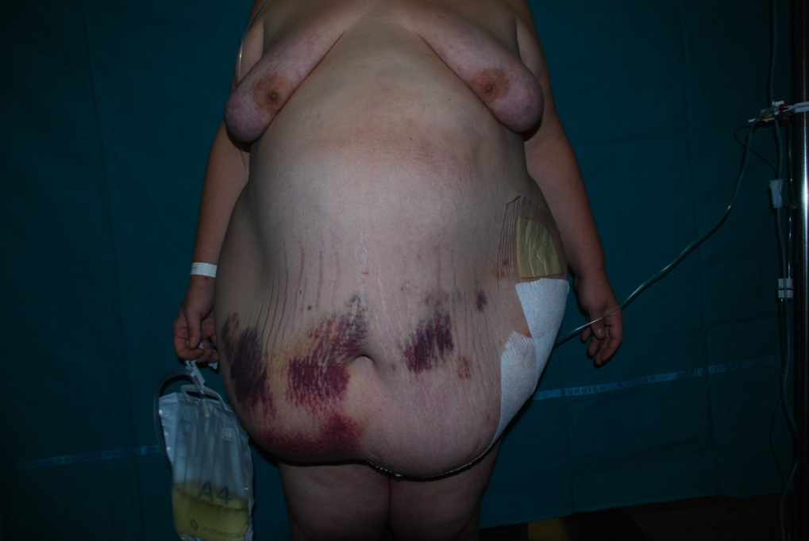
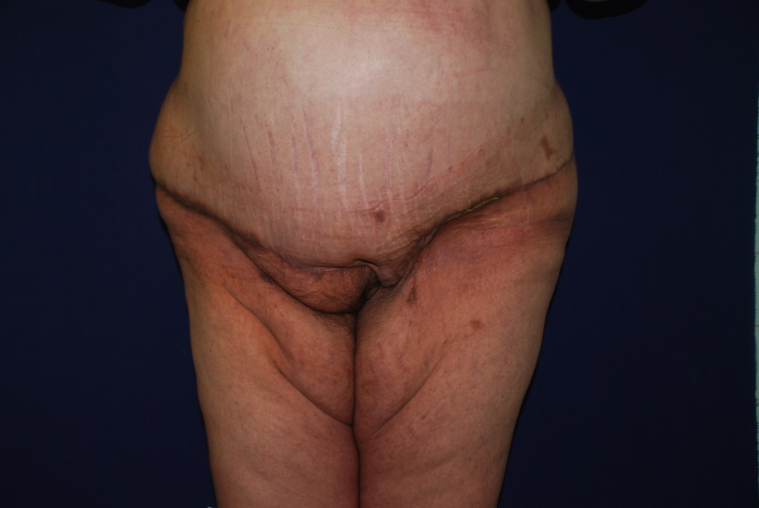
Fournier’s Syndrome in mega-obese
Exposed bladder and poor debridement
NPWTi for Escherichiae Coli
day 12
2 months
NEGATIVE SWABS
short treatment time
improved treatment safety
Vindigni V, Scarpa C, Dalla Venezia E, Bassetto F. Fournier's Gangrene and Negative Pressure Wound Therapy: A Case Report. Wounds. 2016 Oct;28(10):E41-E43.

Slide 16
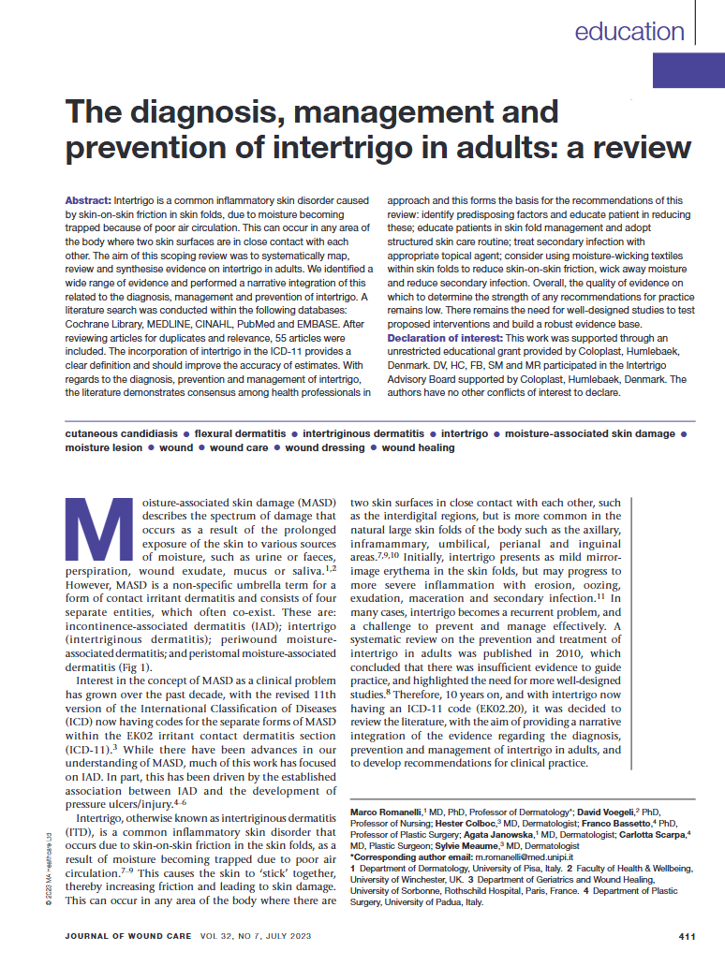
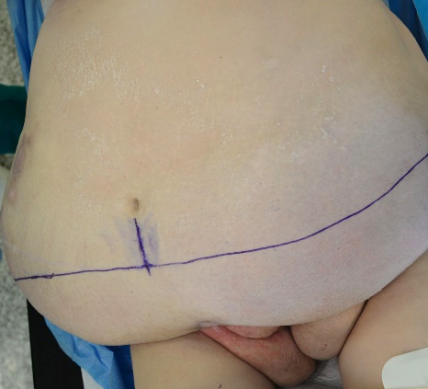
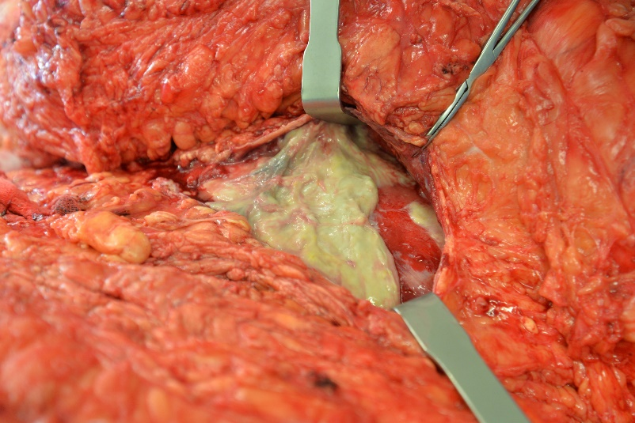
Infection in mega-obese
Megaabdominoplasty and
NPWTi for Escherichiae Coli
2 months

Slide 17
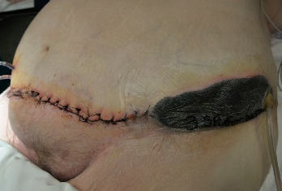
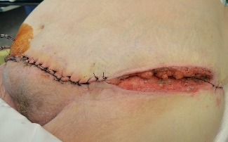
Infection in mega-obese
Megaabdominoplasty and
NPWTi for Escherichiae Coli
2 months
NEGATIVE SWABS AND BIOPSY AFTER 10 DAYS

Slide 18
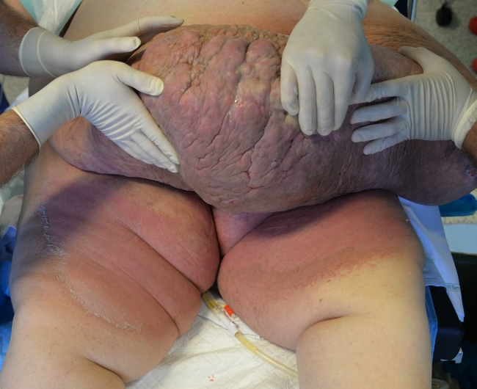
Infection in mega-obese
Megaabdominoplasty and
NPWTi for Klebsiella Pneumoniae

Slide 19
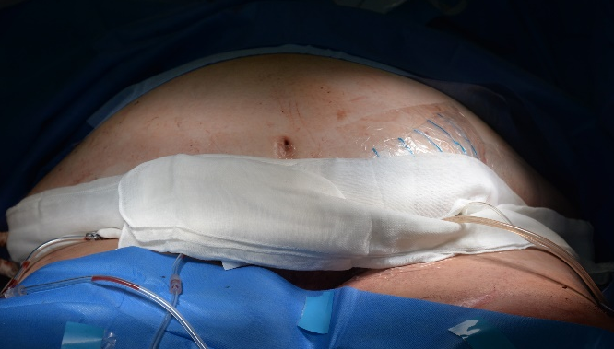
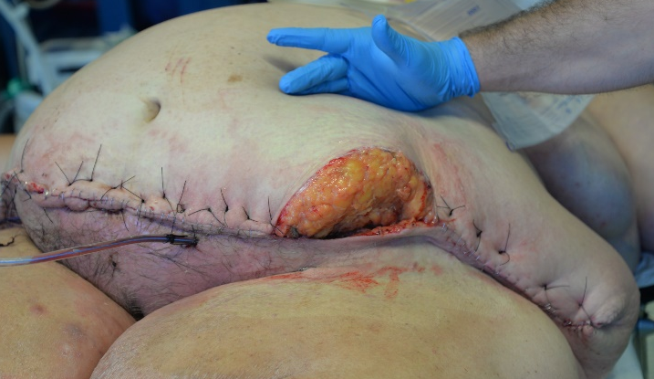
Infection in mega-obese
Megaabdominoplasty and
NPWTi for Klebsiella Pneumoniae
2 months
NEGATIVE SWABS AND BIOPSY AFTER 10 DAYS

Slide 20

Yes…. but to prevent not to treat

Slide 21


NEGATIVE PRESSURE THERAPY
FOR SINGLE USE
Closed Incision Negative Pressure Therapy (CiNPT)
AIM
IMPROVEMENT OF SCAR QUALITY
EASIER POST OPERATIVE MANAGEMENT (FOLLOW UP)
CONTROL OF INFLAMMATION AND EXUDATE
REDUCTION OF COMPLICATION IN HIGH RISK PATIENTS
Notes:
21
21

Slide 22


NEGATIVE PRESSURE THERAPY FOR SINGLE USE
Closed/Portable Incision Negative Pressure Therapy (Ci/piNPT)

Slide 23





Closed Incision Negative Pressure Therapy (CiNPT)
Post bariatric patients
GASTRIC
BY PASS
BMI 50.5→32
PICO 7 DAYS
Notes:
Busacca Eleonora
23

Slide 24



2 months
2 months

Slide 25

Grazie

